Slide 1


MESOESTRUCTURED SBA-15 MATERIALS
WITH AMINO GROUPS
FOR CO₂ CAPTURE
Prof. GUILLERMO CALLEJA
Departamento de Tecnología Química y Energética
UNIVERSIDAD REY JUAN CARLOS
Madrid (España)
SAASA-2. San Luis (Argentina), Febrero 2013

Slide 2

Notes:
Dos perspectivas de Madrid menos habituales: Plaza Mayor al ponerse el sol, con sus terrazas…y

Slide 3

Spain football world championship-UEFA-2012
Notes:
…y otra quizá mas conocida.

Slide 4



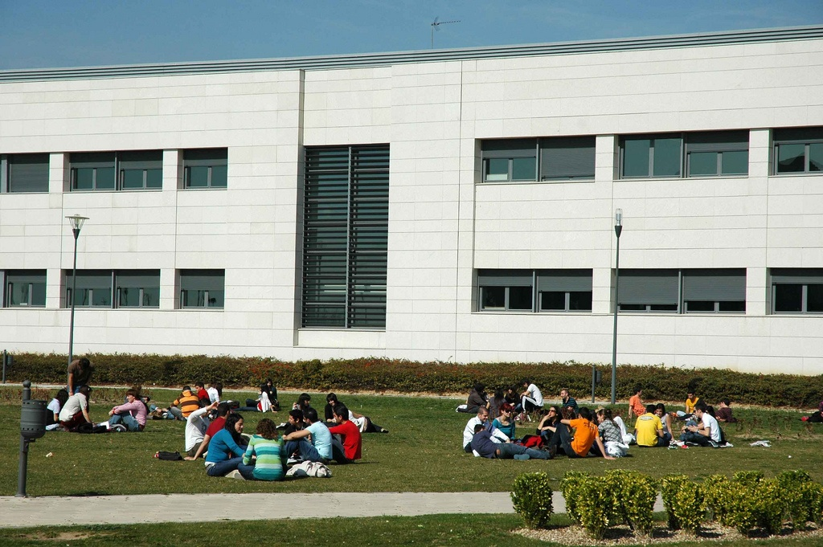
Notes:
URJC

Slide 5
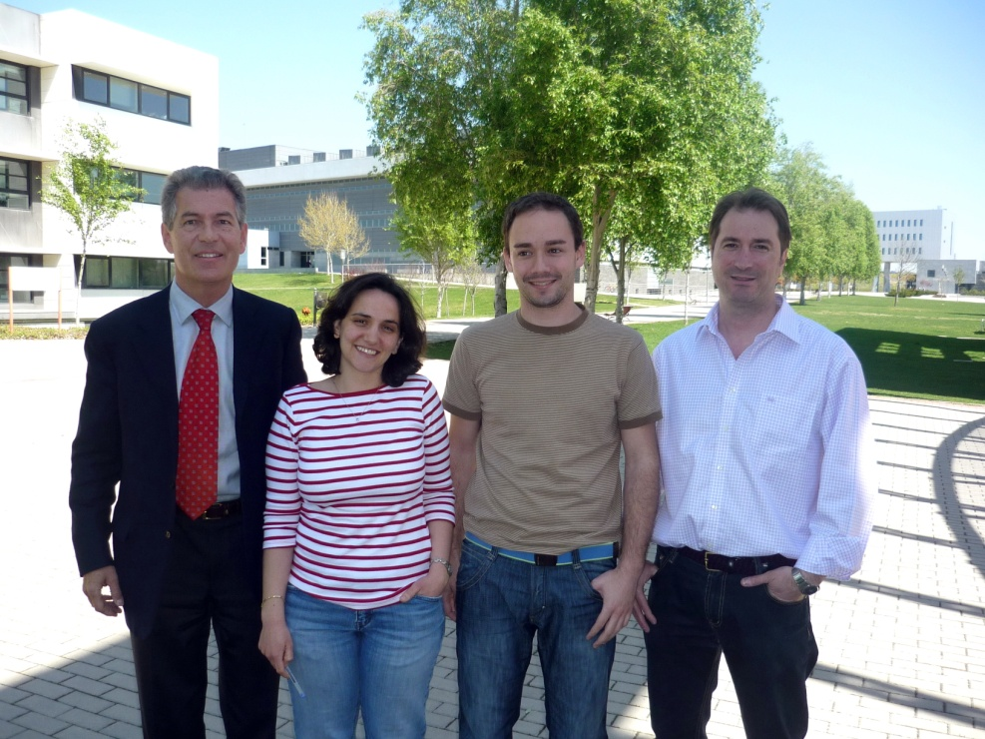
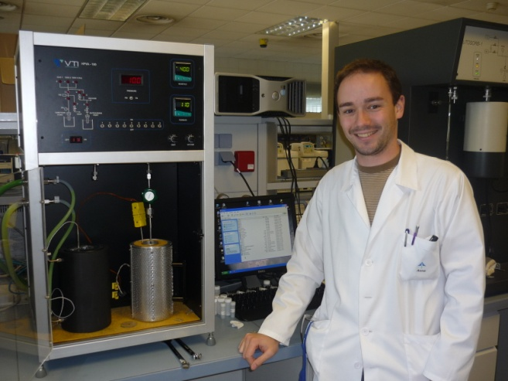
TEAM
(co-authors)
Raul Sanz
Amaya Arencibia
Eloy Sanz (PhD)
Notes:
Equipo de trabajo en adsorción de CO2 con materiales mesoestructurados

Slide 6
MESOESTRUCTURED SBA-15 MATERIALS WITH AMINO GROUPS
FOR CO₂ CAPTURE
OUTLINE
Introduction
Objective
Experimental procedure
  Synthesis of SBA-15
  Grafting
  Impregnation
Results
  Conventional SBA-15
  Pore-expanded SBA-15
  Double functionalIzation
Conclusions

Slide 7
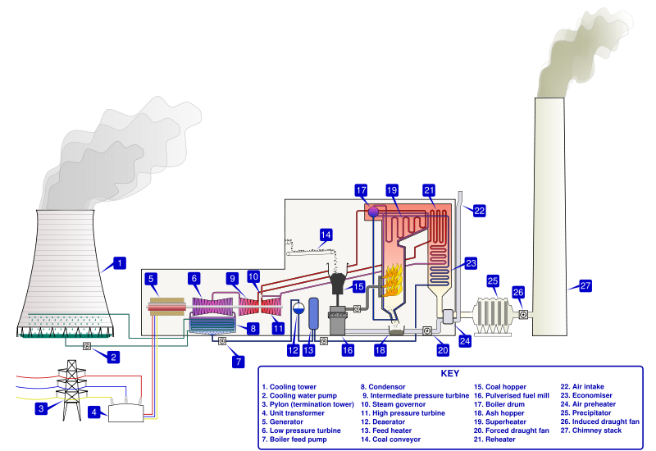
INTRODUCTION
CO₂ emissions in a typical coal-fired power plant
Flue gas after desulphurization leaves at 45º - 70ºC
Atmospheric pressure
Flue gas composition:
70-75% N₂
10-15% CO₂
4-6% O₂
100-150 ppm SO₂, NOx
10-12% H₂O
CCS: Carbon Capture and Sequestration
CCS process increases cost of electricity producction by 50%
CO₂ capture cost is as much as 75% of total CCS cost
Reducing cost of CO2 capture is critical for CCS process

Slide 8
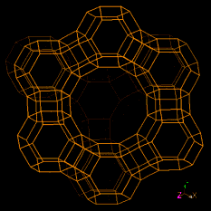
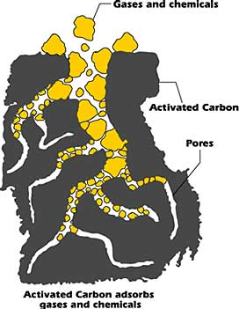
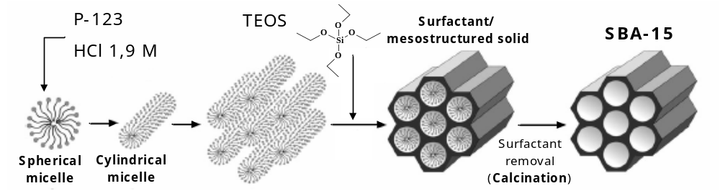
INTRODUCTION
Fundamentals of CO₂ capture technologies
Absorption
Adsorption
Liquid amine solutions (MEA, DEA)
Problems:
Low CO2 capture capacity
Corrosive materials
Vaporization of amines
Amine degradation: waste products
Solvent regeneration requires high energy consumption (70% of operational costs)
It is not a commercially optimal process
Selective adsorbents
Specific active sites for CO₂
Higher CO2 capture capacity
Reduced toxicity and corrosion
No vaporization
Low waste production
Lower energy consumption in regeneration
Can be a suitable competitive technology
Activated
carbons
Zeolites
Mesostructured
materials

Slide 9
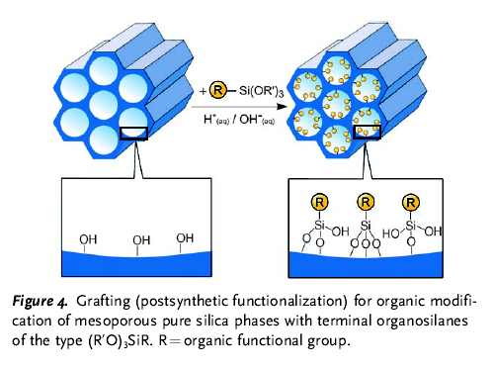
UNIVERSIDAD REY JUAN CARLOS
Departamento de Tecnología Química y Energética
Grupo de Ingeniería Química y Ambiental
Synthesis and characterization of mesoporous functionalized materials
for CO₂ capture
SBA-15 Mesoporous materials
Easy pore control: D_{PORE} = 20-500 Å
High pore volume
High surface area
Tunable surface properties
Mesoporous support

Slide 10
UNIVERSIDAD REY JUAN CARLOS
Departamento de Tecnología Química y Energética
Grupo de Ingeniería Química y Ambiental
Synthesis and characterization of mesoporous functionalized materials
for CO₂ capture
SBA-15 Mesoporous materials
Easy pore control: D_{PORE} = 2-50 nm
High pore volume
High surface area
Tunable surface properties
+
R
Si(OR´)₃
CO₂
Drafting with organic functional groups
Amino groups (-NH₂)
R
Mesoporous support
Functionalized
mesoporous support

Slide 11
OBJETIVE
Synthesis and characterization of SBA-15 materials:
          conventional pore size
          pore-expanded
Incorporate molecules with amino groups
Explore joint action of GRAFTING and IMPREGNATION
N
N
N
N
N
N
N
N
N
N
N
N
N
N
N
N
N
N
N
N
N
N
+
N
N
N
=
GRAFTING
Low nitrogen content
High amino efficiency
IMPREGNATION
High nitrogen content
Lower amino efficiency
DOUBLE FUNCTIONALIZATION
(Grafting+Impregnation)
High nitrogen content
High amino efficiency
Notes:
En el presente trabajo se han sintetizado soportes silíceos mesoestructurados tipo SBA-15 con tamaño de poro expandido. Posteriormente, se ha llevado a cabo la incorporación de moléculas que contienen grupos amino mediante la combinación del anclaje químico y la impregnación, dos técnicas habituales de funcionalización. El objetivo que se ha perseguido ha sido la incorporación de dos tipos de moléculas: una de ellas incorporada por anclaje que quedará fija y otra que podría ser móvil que se incorpora por impregnación. De esta manera, se intenta tener dos tipos de grupos amino que faciliten la captación del CO2 mediante una primera reacción para formar el Zwitterion y la segunda para captar el protón por medio de la base.
De esta manera se pretende mejorar la incorporación de las moléculas aminadas y su movilidad en el interior de los poros, así como facilitar la difusión del CO2 a través de los poros del material una vez funcionalizado.

Slide 12
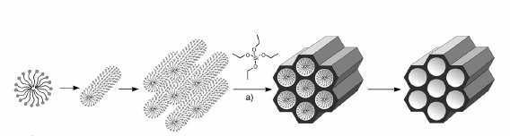
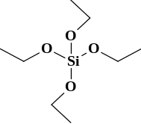
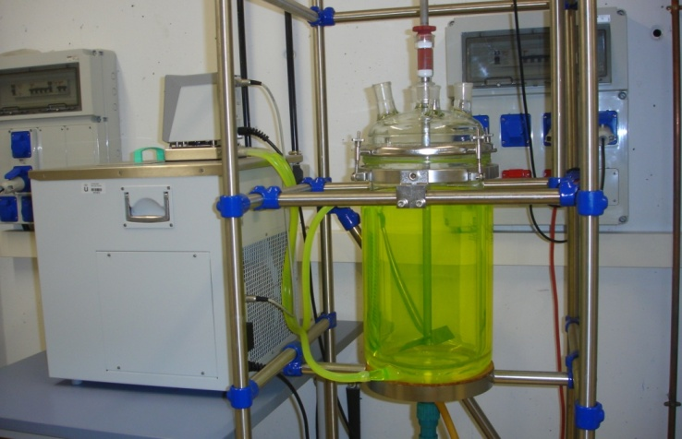
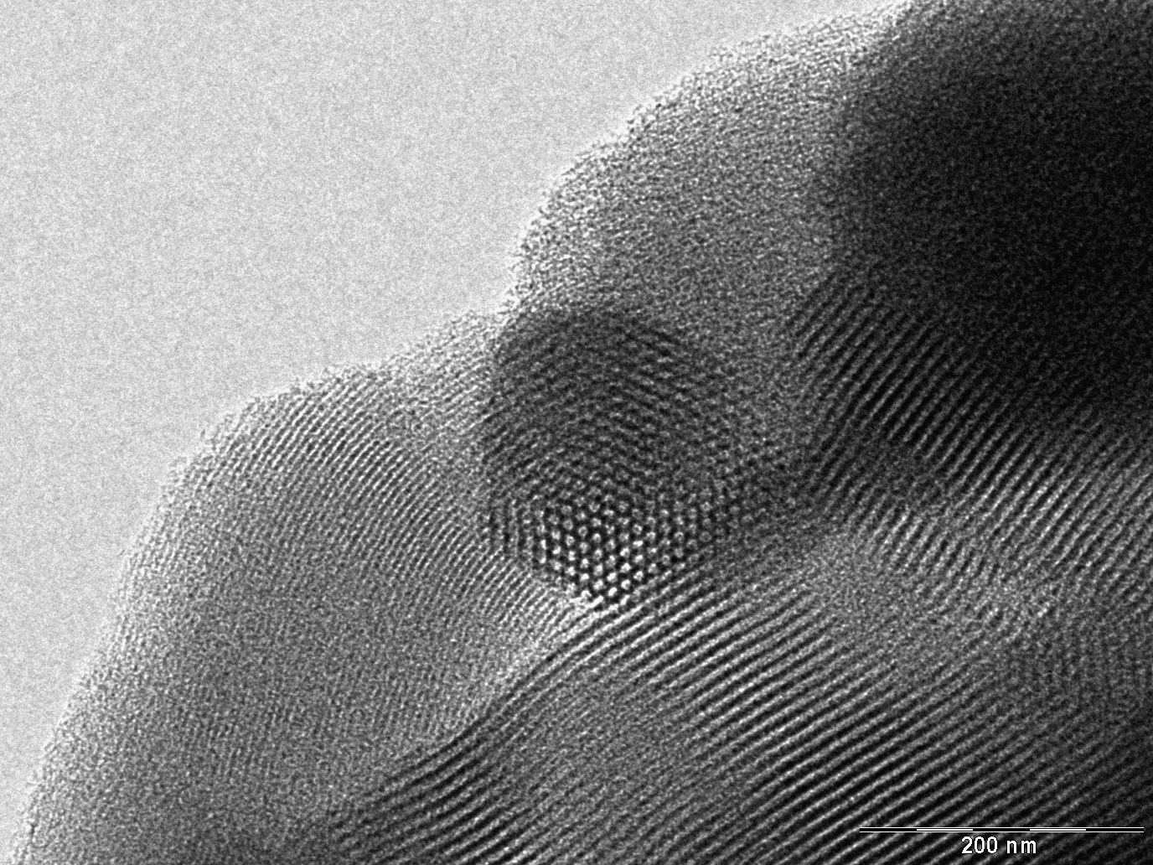
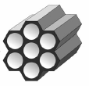
EXPERIMENTAL PROCEDURE
  SBA-15 Synthesis
Surfactant
inside pores
P-123
Non-ionic surfactant
TEOS
precursor
+ TEOS
Spherical micelle
Cylindrical micelle
Surfactant
Removal
(Calcination, extraction)
SBA-15
Stirred tank 15 l
TEM image
Mesoporous
ordered material
Dp = 9 nm
P-123 (Pluronic)
HCl 1,9 M
Disolution
+ TEOS Hydrolisis
Ageing
Calcination
2h, RT
20h, 40ºC
24h, 110ºC
5h, 550ºC
D. Zhao et al., Science, 1998
Notes:
El material SBA-15 se sintetiza en condiciones de reacción fuertemente ácidas usando surfactantes no iónicos como directores de estructura. Actualmente se está prestando particular atención a surfactantes poliméricos no iónicos del grupo de los óxidos de polietileno (PEO) de alto peso molecular, concretamente al copolímero tribloque PEOXPPOYPEOX (óxido de etileno-óxido de propileno-óxido de etileno) denominado Pluronic (P123)
The main steps in the synthesis of SBA-15 support are shown here. The surfactant, Pluronic P123, which is the structure directing agent, is dissolved in hydrochloric acid and then, the silica precursor source, tetra-ethyl-ortosilicate (TEOS), is added to the previous mixture. After ageing, washing and air drying at room temperature, the surfactant is removed by a thermal treatment (calcination). We have carried out the synthesis in a mixer with a volume of 15 litres. Using a reaction volume of 3 litres, being the total amount of calcined SBA-15 obtained of approximately 30 grams.
Pore diameter of materials thus obtained are about 9 nm

Slide 13
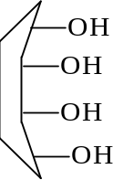
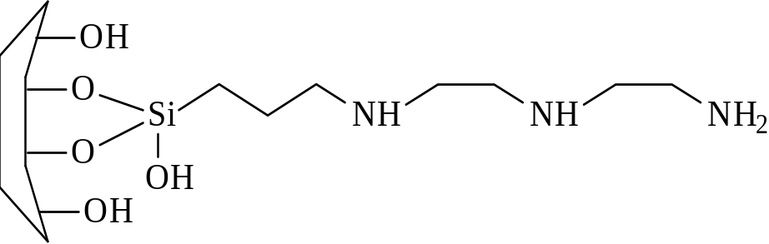
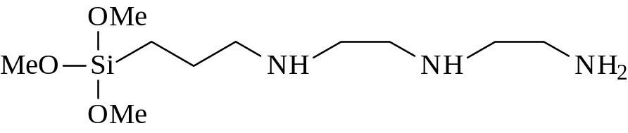
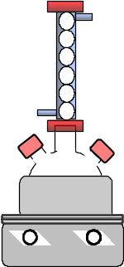

EXPERIMENTAL PROCEDURE
SBA-15 Functionalization by GRAFTING
+
SBA-15
SBA- DT(NNN)
DT (NNN)
Diethylen-triamino-propyl metoxysilane
Calcined SBA-15
Toluene
100mL
Functionalization agent
AP(N), ED(NN), DT(NNN)
Reflux
24 h
Filtration/
Washing
Drying
111ºC
200 mL toluene
Notes:
The functionalization of SBA-15 is carried out by the grafting method that involves the reaction between the silanol groups (-SiOH) of the support and the metoxi groups of the functionalizing agent.
SBA-15 is dispersed in toluene, then the functionalization agent is added and the mixture was maintained at reflux for 24 hours at the boiling temperature of the mixture. The final solid is recovered after filtration and washing with toluene. Then the drying step is carried out. Drying conditions are important for obtaining good CO₂ adsorption capacities and amine group stability.

Slide 14
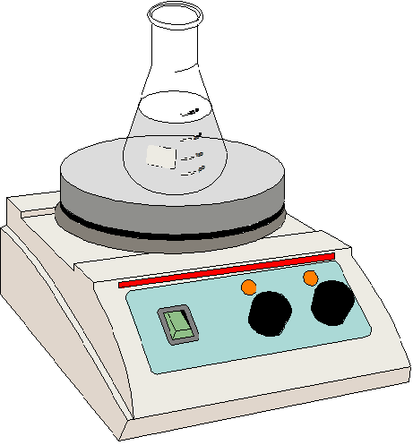
EXPERIMENTAL PROCEDURE
Synthesis of PORE-EXPANDED SBA-15
Pluronic 123
surfactant
TEOS
precursor
Pore-expanding agent
TIPB
HCl 1,3
solution
TIPB: Tri-isopropyl-benzene
Hydrolysis T
17 ºC
Calcination (550º C)
PE-SBA15-c
Ageing, 110 ºC
Extraction (EtOH)
PE-SBA15-e
Dp = 12-15 nm
Notes:
Síntesis del material mesoestructurado SBA-15 de tamaño de poro expandido siguiendo dos estrategias: modificación de la temperatura de hidrólisis y utilización de un agente de hinchamiento (TIBP)
Inicialmente se produce la polimerización del precursor silíceo (TEOS) en disolución acuosa alrededor de las micelas de surfactante (Pluronic-123) previamente formadas. La fuente de silicio más usada para la síntesis del material SBA-15 es el tetraetilortosilicato (TEOS). No obstante, también se puede emplear metasilicato de sodio, con el que se obtienen materiales con propiedades comparables a los preparados a partir del tetraetilortosilicato [29-31]. Una vez formado el material mesoporoso con la estructura deseada se procede a la eliminación del surfactante que se encuentra ocluido en los poros del material. Esto se puede hacer por calcinación o por extracción con un disolvente (etanol). Los poros resultantes son mayores que los de SBA-15 convencional, pudiendo variar entre 12 y 15 nm, según el tratamiento de eliminación del surfactante. La técnica de calcinación es mas agresiva, pudiendo producir una contracción parcial de la estructura (menor Dp), mientras que la extracción no es tan eficiente en la eliminación del surfactante, pudiendo quedar algo del mismo sin eliminar.
El TIPB conduce al hinchamiento de las micelas preexistentes, disminuyendo el cociente volumétrico entre las fases hidrofílica e hidrofóbica, lo cual da lugar, entre otras, a estructuras micelares cilíndricas [124, ].
Sun, J.; Ma, D.; Zhang, H.; Wang, C.; Bao, X.; Su, D. S.; Klein-Hoffmann, A.; Weinberg, G.; Mann, S. J. Mater. Chem. 16 (2006) 1507.

Slide 15

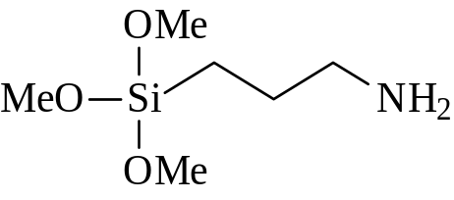
EXPERIMENTAL PROCEDURE
Functionalization of PORE-EXPANDED SBA-15 by GRAFTING
Amino-organic chains
AP(N) or DT(NNN)
Grafted adsorbents
PE-SBA15-N(X)
PE-SBA15-NNN(X)
PE-SBA15
+
Toluene washing
Filtering
Drying
X: 2, or 6 SiOH/nm²
Calcined silica at 550ºC:
1,7 Si-OH/nm²
Van der Voort et al., Far. Trans., 1991
Toluene
AP(N): 3-aminopropyl-trimethoxisilane
DT(NNN): Diethylen-triamino-propyl metoxysilane
Notes:
La funcionalización de materiales silíceos mediante anclaje consiste en una reacción química entre los grupos silanol superficiales del sólido y un compuesto precursor del grupo orgánico a incorporar. En este trabajo se han usado como agentes de funcionalización las moléculas 3-aminopropiltrimetoxisilano y N-[3-(trimetoxisilil) propil] dietilentriamino, donde los grupos metoxi reaccionan con los grupos silanol de la superficie del soporte. Puesto que poseen uno y tres grupos amino respectivamente a modo de simplificación estas moléculas se nombrarán como AP(N) y DT(NNN).
Para llevar a cabo el anclaje del compuesto AP(N) y DT(NNN) sobre el material SBA-15 es necesario dispersar 1 g del soporte en 250 mL de tolueno y añadir el agente de funcionalización en la concentración deseada. La cantidad de agente de funcionalización se calcula en función de la concentración estimada de grupos silanol superficiales del soporte, tomando como referencia una sílice calcinada a 550 ºC (Van der Voort, 1991).
Tras adicionar el agente de funcionalización, la mezcla resultante se mantiene 24 h con calefacción constante a reflujo. Transcurrido el tiempo indicado, se procede a la filtración a vacío, lavado con tolueno y secado a temperatura ambiente.

Slide 16

EXPERIMENTAL PROCEDURE
Functionalization of PORE-EXPANDED SBA-15 by IMPREGNATION
Amino-organic chains
PEI or TEPA
Impregnated adsorbents
PE-SBA15-PEI (Y)
PE-SBA15-TEPA (Y)
PE-SBA15
+
Filtering
Drying
Y: 30 or 50%
PEI: polyethyleneimine
OH
OH
OH
OH
OH
OH
OH
OH
OH
OH
OH
TEPA: tetraethylene-pentamine
Notes:
De forma analoga, se lleva a cabo la impregnación del soporte SBA-15 con moléculas aminadas, como TEPA (tetraetilen-pentamina) con 5 grupos amino en su molécula, o PEI (Poli-etilenimina), polímero de elevado peso molecular (M=800) que contiene numerosos grupos amino primarios, secundarios y terciarios (éstos últimos no activos en la quimisorción del CO2).

Slide 17
EXPERIMENTAL PROCEDURE
Characterization of materials
Techniques used:
    N₂ adsorption-desorption at 77 K
    X-Ray Diffraction (DRX)
    Elemental Analysis (HCN)
    Thermogravimetry (TGA)
    Transmision Electron Microscopy (TEM)
    CO₂ Adsorption:
    - Volumetric analysis
Pure CO₂
T = 45 ºC
P = 0,5 – 6 bar
15 % CO₂ , 80 % Ar, 5 % O₂
(H₂O saturated)
T = 45 ºC
P = 1 bar
- Fixed bed adsorber + MS

Slide 18
EXPERIMENTAL PROCEDURE
N₂ adsorption isotherms (77 K)
Micromeritics TRISTAR 3000
Degasification: T=150ºC ; 8 h
S_{BET} was calculated at P/P₀ between 0.05 and 0.2, D_{P} with BJH method
(adsorption branch) and V_{P} at P/P₀= 0.97
Pure CO₂ adsorption isotherms
Volumetric analyzer - Scientific Instruments HPVA-100 (VTI)
Degasification: T=110ºC; p=3 mbar; 2 h.
CO2 Adsorption: T=45ºC (0.5-6 bar)
Thermogravimetric mesasurements
TA instruments SDT Simultaneous 2960 Thermobalance
Degasification: 100mL/min N₂ 110ºC; Analysis: 100mL/min CO₂ at 45ºC.
Fixed bed CO₂ adsorption (gas mixtures)
(15% CO₂, 80% Ar, 5% O₂) + Water (saturated, 5% vol.)
Fixed bed + MS: PID Eng.&Tech Microactivity Reference;
MS: Pfeiffer Vacuum QMG 220
D = ½” ; L=15 cm
m = 400 mg
Q_{T} = 120 ml/min (Ar)
3 independient mass flow meters
Degasification: T=110ºC; Q= 200 ml/min(Ar); 2 h.
CO2 Adsorption : T=45ºC
Notes:
18

Slide 19
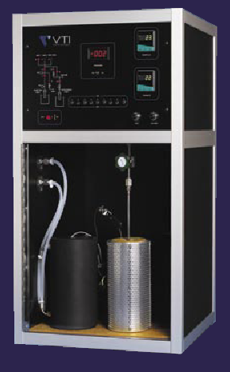
CO₂volumetric adsorption
(isotherms)
Scientific Instruments
HPVA-100 (VTI)

Slide 20
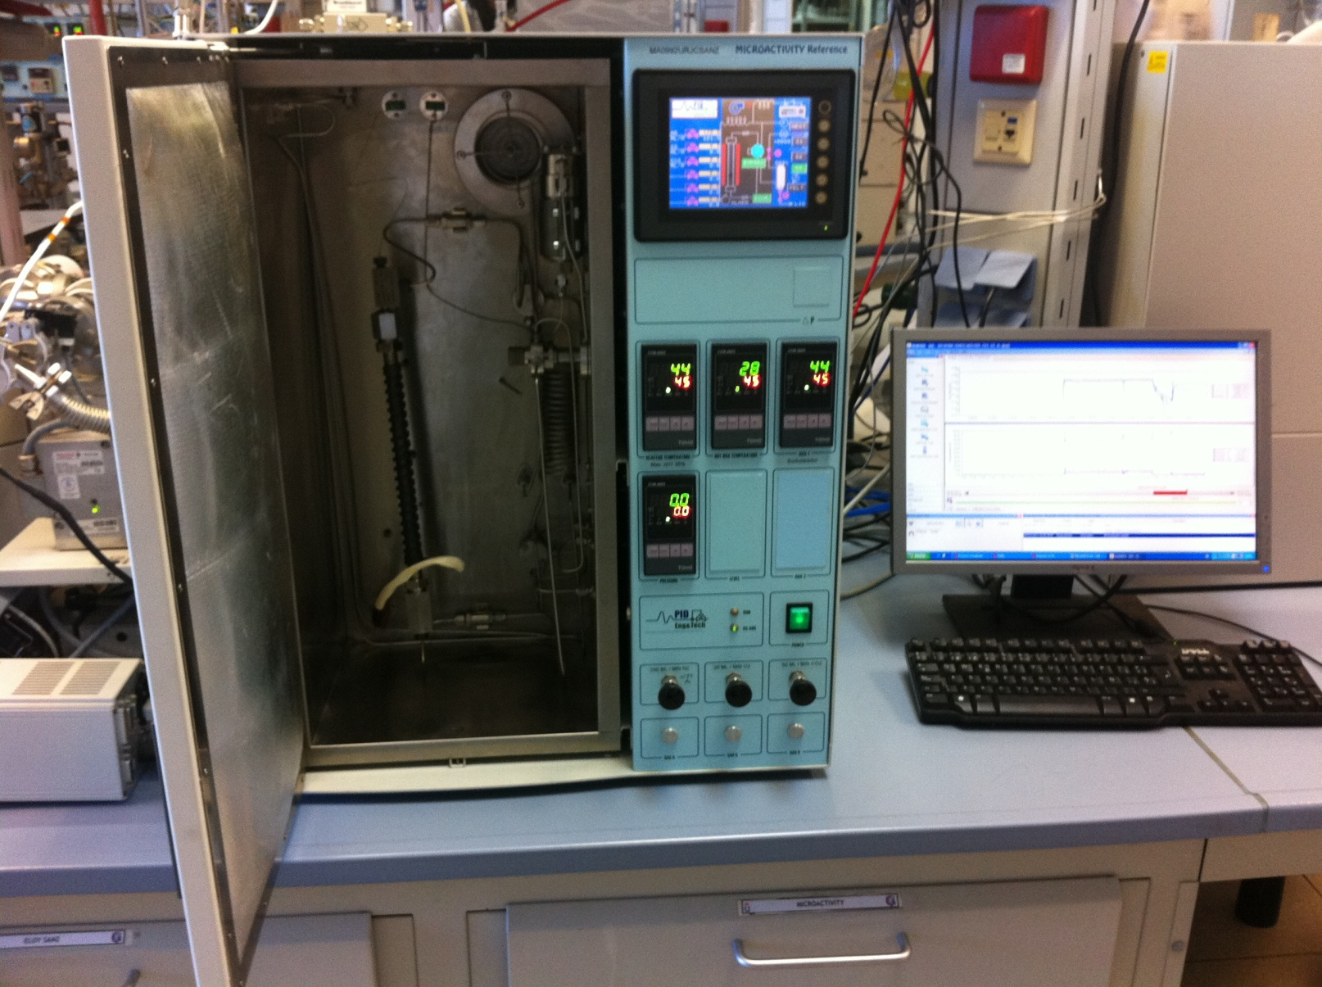
Adsorption fixed bed+ MS

Slide 21
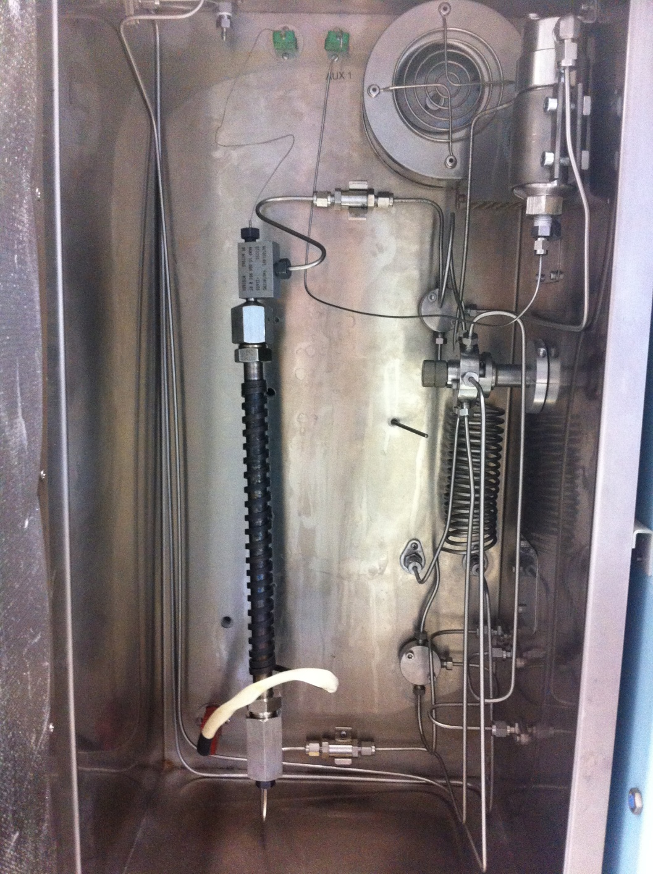
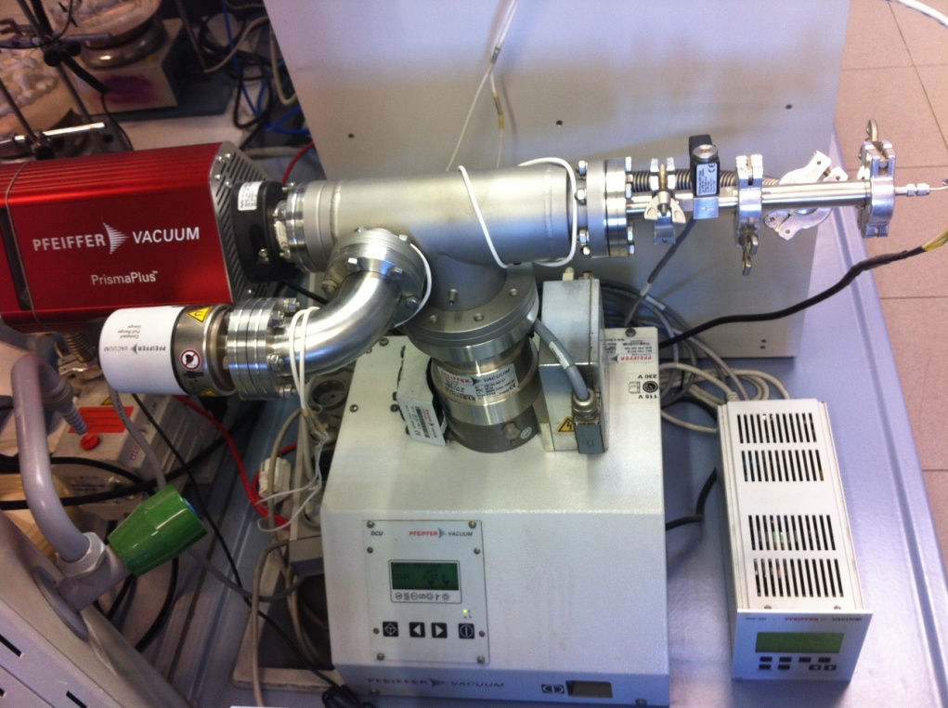
Adsorption fixed bed
MS spectrometer

Slide 22
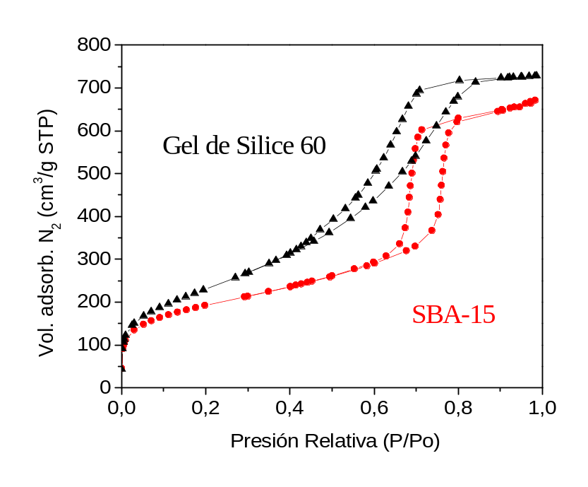
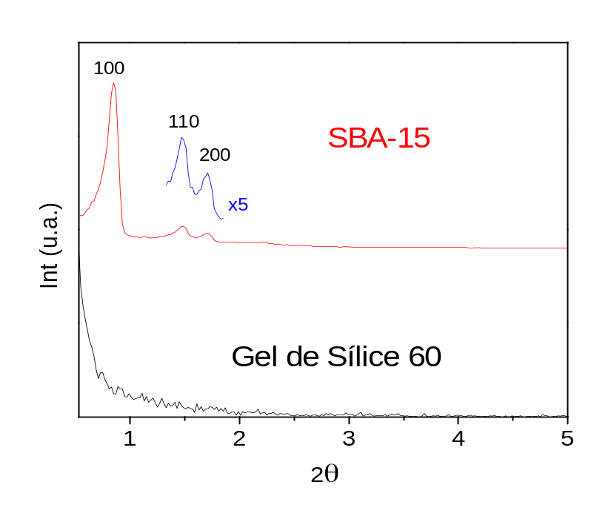
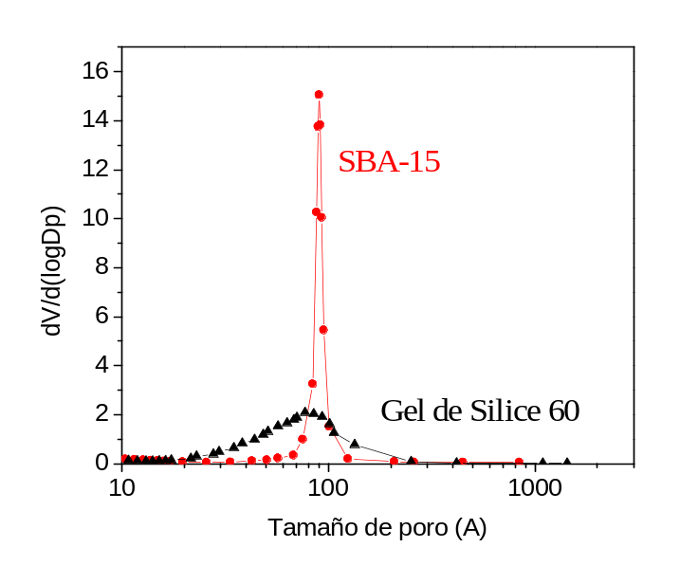
RESULTS – SBA-15
SBA-15 Characterization
N₂ adsorption, 77 K
XRD
Textural properties
Material | S_{BET} (m²/g) | V_{PORE} (cm³/g) | D_{PORE} (Å)
SBA-15 | 692 | 1,03 | 90
Silica Gel | 841 | 1,12 | 30-150

Slide 23
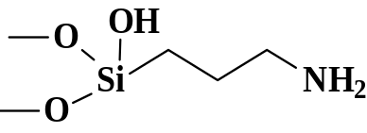
Drafting of SBA-15
O
M
e
Alkyl-metoxy-silane groups form covalent links with SiOH
MeO
S
i
R
O
M
e
CO₂
Surface reactions between
Amino groups and CO₂
Mechanism:
1
2
Dipolar ion
CO₂
O
O
H
S
i
N
H
2
+
C
O
O
-
R
O
Zwitterion
3
Ammonium
Carbamate
N
H
AP(N)
O
H
Zwitterion
4
2
O
O
H
ED(NN)
S
i
N
H
2
+
C
O
O
-
O
N
H
N
H
2
O
S
i
N
H
C
O
O
-
O
N
H
N
H
N
H
O
N
H
+
DT(NNN)
S
i
3
Basic group
O
O
H
Notes:
SBA-15 has been functionalized with the three organosilane molecules containing the amino groups. The interaction of these molecules with the silanol groups is strong, being covalent bonds formed, stronger than conventional van der Waals forces of typical physi-sorption.
Since the molecule of carbon dioxide has an acidic character and the amino groups are basic, a chemisorption takes place between them, forming as a first step a dipolar ion, called “Zwitter-ion”, which further interacts with another basic amino group of a neighbour grafted molecule, to the form an alkyl-amonium carbamate. This is what is expected to occur in anhydrous conditions.

Slide 24
Drafting of SBA-15
Surface reactions between amino groups and CO₂
in the presence of water
Ammonium
Carbamate
Ammonium
Bicarbonate
4
5
CO₂ +
2 H₂O
O
O
H
O
O
H
S
i
N
H
C
O
O
-
S
i
N
H
+
H
C
O
-
O
O
3
3
O
O
+
-
S
i
N
H
+
S
i
N
H
3
H
C
O
3
3
O
O
O
H
O
H
Efficiency:
0,5 mol CO₂ /mol amine
1 mol CO₂ /mol amine
Adsorption uptake depends on amine density and total N content
(i.e., amount of silanol groups in the surface)
SBA-N(X)
X = 2 o 6 SiOH/nm²
Calcined silica at 550 ºC: 1,7 Si-OH /nm²
Van der Voort et al., Far. Trans., 1991
Notes:
When water is present, the mechanism of CO2 reaction leads to the formation of amonium bicarbonate, a more stable final form, being involved 2 CO2 molecules as well as 2 water molecules.
The minimum amine amount to be used for grafting is determined by the surface silanol concentration, which is assumed to be about 2 SiOH/nm2, according to previous studies with calcined silica. To be sure that most of the silanol groups are used for grafting, an excess of amine was also used in the grafting step: 6 SiOH/nm2

Slide 25
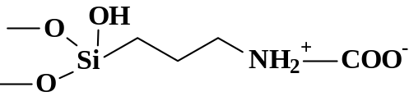
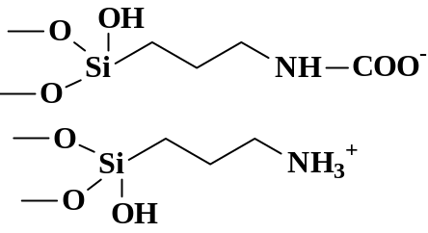
CO2 adsorption mechanism
Primary Amines
Zwitterion
Carbamate
CO₂
Secondary Amines
Zwitterion
Carbamate
O
O
H
R
CO₂
S
i
N
C
O
O
-
O
O
S
i
N
H₂
+
O
O
H
R
Tertiary Amines
CO₂
Carbamate
Notes:
Ammonium carbamates cannot form with tertiary amino groups, because there are no hydrogen atoms available linked to the nitrogen atom, and the mentioned mechanism cannot take place.

Slide 26
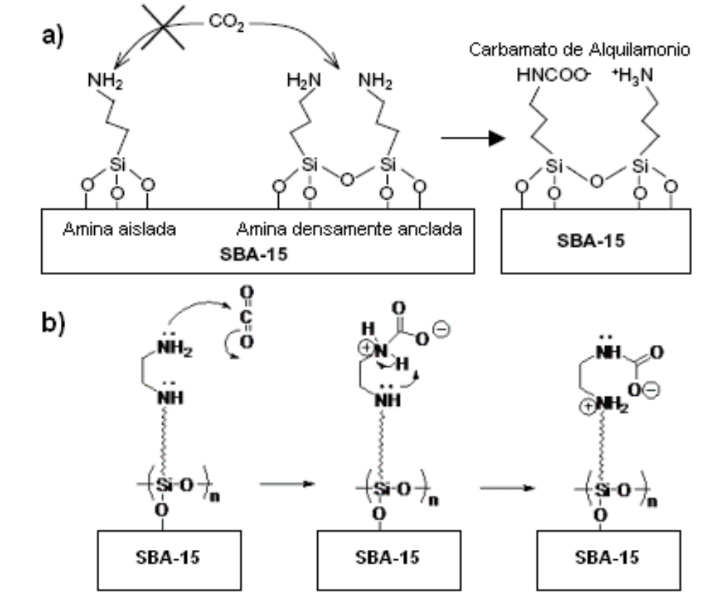
CO2 adsorption mechanism
intermolecular
internal
carbamate
Leal et al. Inorg. Chim. Acta 1995
Notes:
Alkyl-ammonium carbamates can be formed either “externally” (two different grafted amine molecules close enough to each other): intermolecular mechanism; or “internally” (two neighbour amine groups of the same grafted molecule): intramolecular mechanism.

Slide 27
CO2 adsorption mechanism
intermolecular
internal
carbamate
intramolecular
Leal et al. Inorg. Chim. Acta 1995
Notes:
Alkyl-ammonium carbamates can be formed either “externally” (two different grafted amine molecules close enough to each other) or “internally” (two neighbour amine groups of the same grafted molecule).

Slide 28
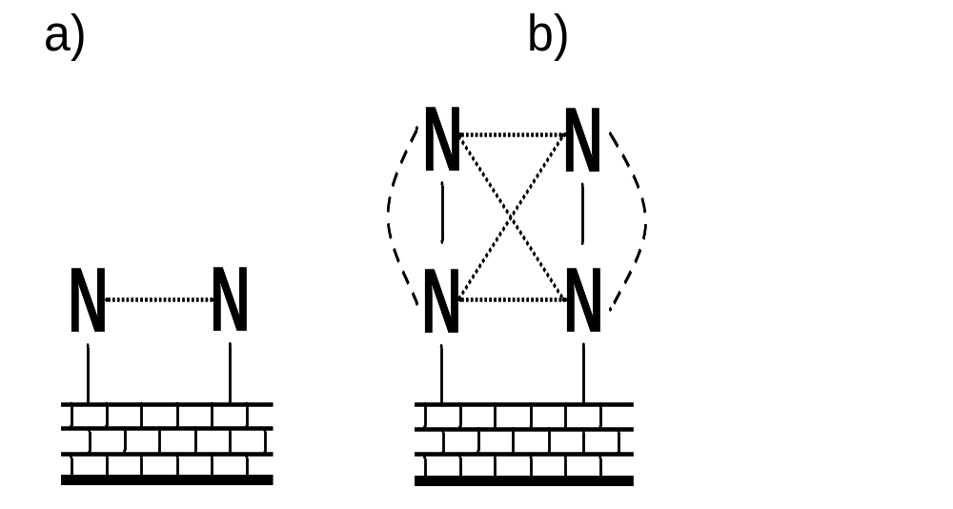
CO2 adsorption mechanism
CO₂
CO₂
CO₂
CO₂
Notes:
Figura 5.35. Representación esquemática de la reacción de CO₂ con dos grupos amino mediante enlaces intermoleculares (líneas punteadas, color rojo) e intramoleculares (líneas rayadas, color azul) en moléculas de a) aminopropil, AP (N) y b) etilendiamo, ED (NN)

Slide 29
Amino groups location byTEM - Staining technique
0% N
Selective RuO₄ staining
0,5 % RuO₄ (aq),15 min.
RuO₄
Image contrast
Amino group distribution and location
Sanz et al. Microp& Mesop. Mater. 158 (2012) 309-317
Polymer microscopy, ed. L. C. Sawyer and D. T. Grubb, Chapman & Hall, London, 1996
Notes:
Sample preparation for TEM measurements was carried out by staining the functionalized SBA-15 with Ruthenium oxide, that is a selective staining agent for amine groups. Ruthenium is a heavy metal that enhances the image contrast by TEM.

Slide 30
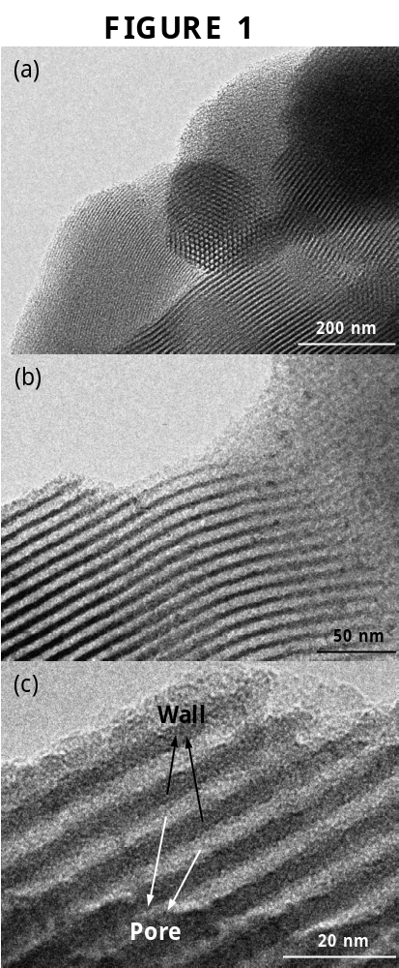
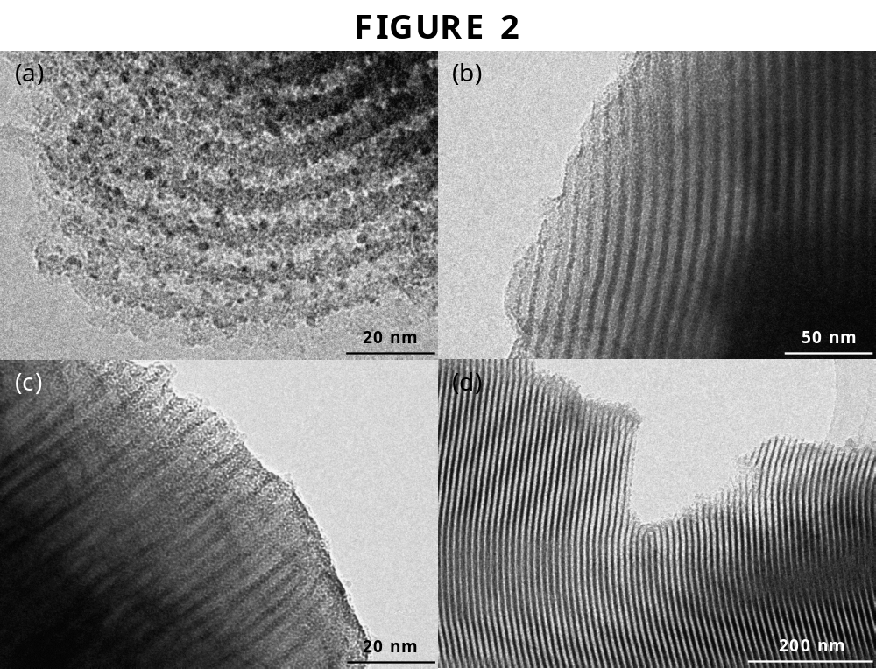
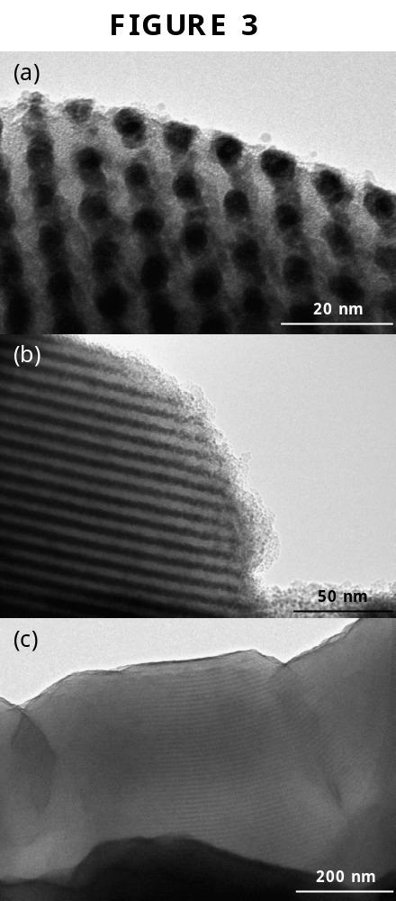
Amino groups location byTEM
Grafted materials
SBA-15
Before treatment
After treatment with RuO₄ : NO CHANGE
Amine-grafted SBA-15 after RuO₄ treatment
SBA15-N-(6)
SBA15-NNN-(2)
RuO₄
-NH groups
Sanz et al. Microp& Mesop. Mater. 158 (2012) 309-317
Notes:
The images shown correspond to the pure SBA-15 support and several samples with different nitrogen content.
It is clearly observed for the lowest N content (SBA-DT-NNN) the black dots of RuO₄ within the channels of the support that are revealing the position of the amino groups. As the nitrogen content increases (images on the right), the pores are progressively filled up with amino groups, and the black dots are now seen as a continuous dark line.
We will see later that the external surface of the sample is also functionalized, as shown by the thicker dark line corresponding to the RuO4 covering the external surface.

Slide 31
RESULTS – SBA-15
CO2 adsorption on amino-grafted SAB-15
N₂ adsorption, 77K
XRD
Sample | S_{BET} (m²/g) | D_{PORE} (Å) | V_{PORE} (cm³/g) | Г org (molec/nm²) | %N
SBA-15 | 692 | 90 | 1.03 | -- | --
SBA15-(N)-6 | 266 | 78 | 0.46 | 2.3 | 3.6
SBA15-(NN)-6 | 228 | 72 | 0.39 | 1.8 | 5.7
SBA15-(NNN)-6 | 150 | 75 | 0.26 | 1.4 | 6.7
Dried at 20ºC, 24h
Different textural properties
Different N content
Notes:
When more amine is added to the SBA-15 during functionalization (considering 6 silanol groups per m2, that is, ratio amine/SiOH = 6), similar results are obtained. Now, although the shape of all isotherms are again similar, the differences among the three isotherms of the functionalized SBA-15 are more evident.
Values of surface area and pore volume show now a decrease in the order AP, ED and DT. However, the amount of nitrogen incorporated is larger.
The XRD graph on the right shows again an important decrease in the intensity of the diffraction peaks with respect to the pure SBA-15, particularly for the sample functionalized with the triamino molecule.
Molecular size of aminated molecules (AP, ED, DT) is relatively small compared to pore size: 10-15 angstroms, so that molecules do not block the pore volume, no matter how much drafting extension. Г org (molec/nm²) is decreasing with longer organic molecules, since these are usually not perpendicular to the surface but occupying some space along the surface (silanol groups no longer accessible)

Slide 32
RESULTS – SBA-15
CO2 adsorption on amino-grafted SAB-15
Sample | S_{BET} (m²/g) | D_{PORE} (Å) | V_{PORE} (cm³/g) | %N | mg CO₂/ g
SBA-15 | 692 | 90 | 1.03 | -- | 19.7
SBA15-(N)-6 | 266 | 78 | 0.46 | 3.6 | 43.9
SBA15-(NN)-6 | 228 | 72 | 0.39 | 5.7 | 60.0
SBA15-(NNN)-6 | 150 | 75 | 0.26 | 6.7 | 66.8
P = 1atm
T = 45ºC
CO₂ adsorption at 45ºC
Reversible adsorption
Partially irreversible
19,7 mg CO₂/g
66,8 mg CO₂/g
SBA-15
SBA15-(NNN)-6
Notes:
We show here CO₂ adsorption results of the materials. The amount of CO₂ adsorbed increases with the N content of the sample, from 19,7 mg CO2/g for pure SBA-15 up to 80.8 mg CO2/g for the sample functionalized with triamine and 10 silanol groups per nm², which is the sample with the highest adsorption capacity. CO2 adsorption runs almost parallel to N content, so that all N is involved in CO2 adsorption.
We can see below the isotherms of pure SBA-15 and SBA with the triamine, DT (NNN)-6. We observe that adsorption capacity at low pressure (1 atm) is much higher when the amine is present, as commented, and that for the functionalized sample the adsorption process is not completely reversible, which indicates that part ot the CO₂ remains within the adsorbent. This behaviour is related to the adsorption mechanisms for both materials, since for pure SBA-15 there is only physical adsorption while for the functionalized SBA-15 there is rather a chemical adsorption, which results from a stronger interaction, as we will see.
Although the desorption process is not totally reversible when lowering the pressure, the adsorbent is completely regenerated when heating at 110ºC.

Slide 33
RESULTS – SBA-15
Cyclic adsorption/desorption of CO₂
SBA15- (NNN)-6
67 mg CO₂/g
Degasification conditions between cycles: 110ºC, 3 mbar, 2h (no air)
  CO₂ adsorption capacity remains unchanged after 4 cycles
Notes:
We can see here that after several consecutive adsorption-desorption cycles, the adsorption capacity of the functionalized materials (in this case illustrated by SBA-DT (NNN)-6) is practically unchanged. Before each cycle, degasification of the sample was carried out at 110ºC and 3 mbar during 2 hours. No air was present during the regeneration process, and therefore, no amine oxidation was produced, so the material keeps the same initial adsorption capacity.

Slide 34
RESULTS – SBA-15
Drying conditions
AIR DRYING
CO₂ adsorption at 45ºC
66.8
mgCO₂/g
1) 20ºC, t= 24h
SBA15-(NNN)-6
2) 110ºC, t= 6, 24, 72h
A chemical change of amino groups
is produced due to chemical oxidation
When drying in air at 110 ºC
13.2
mgCO₂/g
By using XPS the reaction products were identified as amides (R‑C=O‑NH‑)
Jones et al. Energy Fuels 25 (2011) 2416-2425
Calleja et al. Top. Catal. 54 (2011) 135-145
Notes:
The best result of CO₂ adsorption of this sample when dried in air at room temperature (25 ºC) for 24 h is 66.8 mg CO₂/g, as mentioned.
However, when drying is air at 110ºC the CO2 adsorption capacity decreases dramatically with the drying time, even below the limit corresponding to pure SBA-15 (19.6 mg/g). The low value of CO2 adsorption for 72 h of drying at 110 ºC (about 13 mg/g) is very similar to that obtained for other SBA-15 materials functionalized with hydrocarbon chains without amine groups, like octylsilane and isobuthylsilane, molecules that have no specific centers to chemically interact with CO₂. So we can conclude that the diamine DT (NNN) molecule grafted to the SBA-15 losses almost completely its capacity for CO2 adsorption after drying at 110ºC for a time long enough (72 h).
Lets see why…

Slide 35
RESULTADOS Y DISCUSION
oculta
Condiciones de secado
Materiales secados al aire a 110 ºC
SBA-AP (N)-6
SBA-ED (NN)-6
CO₂ adsorption
SBA-DT (NNN)-6
N content
Los grupos amino primarios en AP(N) no se afectan por el secado a 110ºC (estables)
Los grupos amino en ED(NN) and DT(NNN) se afectan mucho
  + La capacidad de ads. CO₂ se reduce notablemente
  + El contenido en N casi no decrece
N
H
AP
2
N
H
N
H
ED
2
N
H
N
H
N
H
DT
Algunos grupos amino sufren cambios químicos
Notes:
The same data are shown here,but in a normalized way, taking 100% as the initial reference for CO₂ adsorption and N content corresponding to the sample dried at room T. The graph on the left shows the decrease of CO₂ adsorption capacity in relation to the sample dried at room temperature (in the vertical axis, 100 means the adsorption capacity of the sample dried at room temperature). The decrease of CO₂ adsorption capacity is clearly observed for the two larger amine molecules, reaching 70 and 80% of their initial value after 72 h at 110 ºC. However the material with the mono-amine, maintains practically unchanged its adsorption capacity.
N content along drying time at 110ºC is shown in the right figure. This content is practically unchanged, being only a slight decrease observable for the diamine and the triamine samples, ED(NN) and DT (NNN), which loose less than 15% of their initial nitrogen content. Once again, N values remain unchanged for the monoamine, AP(N)
We conclude that:
Primary amine groups in AP(N) are not affected by drying at 110ºC, whereas amine groups in ED(NN) and DT(NNN) molecules are strongly affected by this treatment, pointing at possible chemical changes that difficult CO₂ adsorption.

Slide 36
RESULTADOS Y DISCUSION
oculta
Condiciones de secado
Materiales secados al aire a 110 ºC
Los grupos amino secundarios son inestables
O
H
O
S
i
N
H
N
H
O
2
O
H
O
H
FTIR - SBA-ED (NN)-6
FTIR -SBA-DT (NNN)-6
Dried at 110ºC
Dried at 110ºC
Nueva banda a 1664 cm⁻¹
Se forma enlace C=O?
Calleja et al. Top. Catal. 54 (2011) 135-145
Notes:
However, samples functionalized with diamino and triamino precursors show different IR spectra. As observed, a new absorption band at 1664 cm⁻¹ appears in both cases, increasing with drying time, being this change more pronounced for the triamine. This new band has been attributed to a C= N double bond, that would probably correspond to other functional groups formed by oxidation.

Slide 37
RESULTADOS Y DISCUSION
oculta
Condiciones de secado
Materiales secados al aire a 110 ºC
Los grupos amino secundarios se oxidan a grupos oxima, -C=N-OH,
y simultáneamente se pierden grupos amino primarios
SBA-15 DT (NNN)
By using XPS the reaction products were identified as amides (R‑C=O‑NH‑)
Si
NH
NH
NH
2
T = 110ºC
Jones et al. Energy Fuels
25 (2011) 2416-2425
O₂ (Air)
Si
N
NOH
+ Oxidation Products
CONCLUSION
La regeneración de la SBA-15
debe hacerse en atmósfera inerte
para evitar la oxidación
de los grupos amino
oxima
Si
N
imina
N
NH₂
Si
N
imina
N
NH
Calleja et al. Top. Catal. 54 (2011) 135-145
Notes:
Samples prepared with the tri-amine precursor, DT(NNN), showed a similar behaviour. Again, secondary amino groups react with the oxygen producing imine or oxime groups and also losing part of the organic chain. This last result has also been confirmed by elemental analysis (N content) of the samples after drying. All nitrogen atoms of the oxime and imine groups are inactive for CO2 adsorption.
These results indicate that the way in which the drying step can be carried out depends on the type of amino group existing in the functionalizing agent. Moreover, this conclusion is also valid for the adsorbent regeneration after CO2 adsorption. When existing molecules with secondary or tertiary amine groups, the regeneration must be carried out under vacuum or under an inert atmosphere.

Slide 38
RESULTS – PE-SBA-15
Characterization of PE-SBA15 supports
N₂ adsorption, 77 K
calcined (c)
extracted (e)
Larger pores
(interparticle porosity)
of smaller particles
Low hydrolisisT (17ºC)
Swelling agent (TIPB)
Sample | BET (m²/g) | Dp (Å) | Vp (cm³/g)
SBA15-c | 692 | 90 | 1,03
SBA15-e | 577 | 97 | 1,06
PE-SBA15-c | 452 | 117 | 1,02
PE-SBA15-e | 428 | 152 | 1,18
Larger pore diameter
Same pore volume
Extracted material selected
(calcination at 550 ºC reduces
no. of SiOH groups)
Calleja et al. Adsorption In Press (2013)
Notes:
Todas las isotermas muestran un mismo comportamiento, que corresponde al tipo IV de IUPAC. Así, aparece una primera etapa a bajas presiones relativas, donde se produce la adsorción en monocapa y en microporos. A continuación tiene lugar la adsorción en multicapa y finalmente el fenómeno de condensación capilar dentro de los mesoporos, que se corresponde con la mayor pendiente observada en las isotermas. La presión relativa a la que se produce el fenómeno de condensación capilar proporciona una idea del diámetro de poro de cada soporte, ya que a mayores diámetros de poro este proceso sucede a presiones relativas mayores. En el proceso de desorción la isoterma presenta un ciclo de histéresis asociado a las diferencias entre el mecanismo de llenado de los poros, que se produce por condensación capilar y el mecanismo de vaciado de los poros.
Estos resultados confirman que la modificación de la temperatura de hidrólisis y la adición de un agente de hinchamiento permite obtener materiales con mayor diámetro de poro: De 90 a 117 y de 97 a 152 angstroms.
El menor diametro de poro del material calcinado (con y sin poro-expandido) se atribuye a una posible contracción parcial causada por la calcinación a elevada T
Consecuentemente, al ser el volumen total de poros similar, la superficie específica de los materiales de poro expandido debe disminuir (poros mas grandes implican menor superficie por unidad de peso, para el mismo Vp. (Es decir, el aumento en el tamaño de poro ha producido una disminución de la superficie específica).
Los tratamientos térmicos de calcinación para la eliminación del surfactante reducen el número de grupos hidroxilo superficiales, de manera que la concentración superficial de estos grupos es menor cuanto mayor sea la temperatura a la que se somete al soporte [138, 139].
El aumento del diámetro de poro de estos materiales por encima de los 120 Å es significativo, ya que este valor ha sido el mayor diámetro conseguido en bibliografía (manteniendo la estructura hexagonal plana) mediante el empleo de TMB, uno de los agentes de hinchamiento más comúnmente usados [124]. Cuando se han conseguido mayores incrementos de diámetro con TMB ha sido a costa de sufrir una transformación de fase, perdiendo la estructura hexagonal y obteniéndose estructuras espumosas (MCF, mesostructured cellular foam)-(P. Schmidt-Winkel, W. W. Lukens, D. Y. Zhao, P. D. Yang, B. F. Chmelka, G. D. Stucky, J. Am. Chem. Soc. 121 (1999) 254).
Debido al valor de Dp tan significativo para la muestra extraida, se decide continuar con ella para los estudios de funcionalización.
También se observa que la cantidad de nitrógeno adsorbida a presiones relativas superiores a 0,9 es notablemente mayor en el material de poro expandido y extraido. Esta adsorción corresponde a poros con una distribución de tamaños ancha, centrada en torno a los 700 Å. Debido a su gran tamaño, es evidente que no se trata de porosidad estructural sino interparticular. El mayor volumen adsorbido a presiones relativas superiores a 0,9 se relaciona con un menor tamaño de partícula o una mayor fragmentación de las mismas, como se comprobó por TEM

Slide 39
oculta
Characterization of PE-SBA15 supports
DRX
Calcined
Ethanol extracted
Pore –expanded SBA-15
Calcination produces a partial contraction of structure (pore size reduction)
Ethanol extraction: no change in structure (but some residual surfactant may remain)
Calleja et al. Adsorption In Press (2013)
Notes:
Todos los materiales muestran 3 señales de difracción en ángulos correspondientes a las familias de planos (100) (110) y (200) lo que indica la existencia de estructura hexagonal plana, característica del material SBA-15.
Los soportes de poro expandido muestran un desplazamiento de sus reflexiones características hacia menores ángulos que los materiales SBA‑15, lo cual se puede relacionar con un mayor espaciado d₁₀₀ y, por tanto, una estructura más abierta en comparación con los soportes de referencia. Este fenómeno es más acusado en los materiales en los que el surfactante ha sido eliminado mediante extracción con etanol.

Slide 40
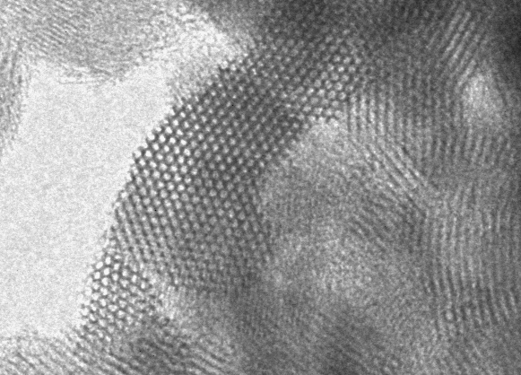
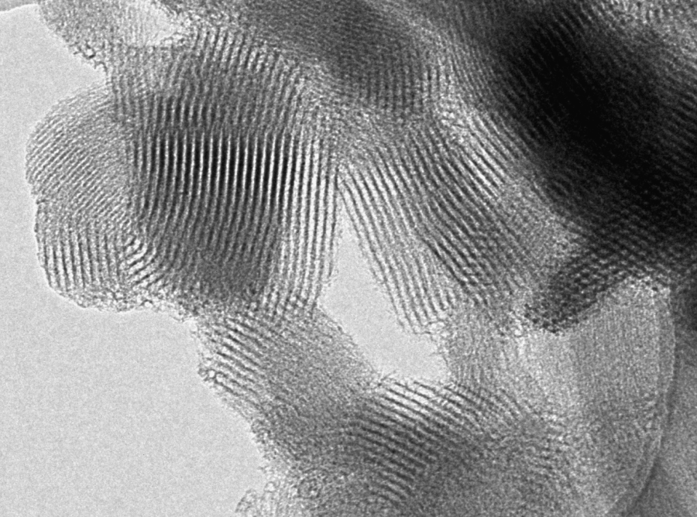
Characterization of PE-SBA15 supports
TEM pictures

Slide 41
PE-SBA-15 grafting with AP(N) and DT(NNN)
Organic load for 6 SiOH/nm²
N₂ adsorption, 77 K
Sample | BET (m²/g) | Dp (Å) | Vp (cm³/g) | % N
PE-SBA15-e | 428 | 152 | 1,18 | -
PE-SBA15-e-(N)-6 | 228 | 118 | 0,66 | 4,4
PE-SBA15-e-(NNN)-6 | 223 | 117 | 0,68 | 6,8
With larger pores,
no significant change in textural properties from (N)-6 to (NNN)-6
Higher N content
(similar to grafted
conventional SBA-15)
Notes:
Utilizando la misma cantidad molar inicial de AP(N) y DT(NNN), se comprueba que ambas moléculas se anclan de forma similar (no hay variación significativa de SBET, Vp, Dp). Sin embargo, debido a que la molécula DT(NNN) presenta tres grupos amino, se consigue con ésta un mayor %N en el anclaje químico.
Si se compara con los resultados del anclaje de SBA-15 normal, allí sí se veía una disminución de SBET y Vp (no de Dp) al pasar de N a NNN, probablemente debido a que al ser los poros mas pequeños, con la misma carga orgánica ocupando proporcionalmente un mayor espacio en los poros, queda menos espacio para el N2 (disminuyte Vp y SBET). En la SBA-15 convencional, el contenido en N de los materiales anclados era similar al de ahora: 3,6 (N) y 6,7 (NNN)

Slide 42
PE-SBA-15 grafting with AP(N) and DT(NNN)
CO₂ adsorption at 45 ºC
Chemisorption (grafted materials):
High adsorption at low P
Non-reversible isotherms (hystheresis)
Physisorption (original PE-SBA-15):
Low adsorption at low P
Reversible isotherm
Sample | N (wt. %) | mg CO₂/g | mol CO₂/ mol N
SBA15-e | - | 12.5 | -
PE-SBA15-e-(N)-6 | 4.4 | 65.7 | 0.48
PE-SBA15-e-(NNN)-6 | 6.8 | 71.4 | 0.34
Higher CO2 adsorption than non-PE materials
Adsorption efficiency of amino groups:
AP(N) > DT(NNN), closest to maximum (0.5)
Calleja et al. Adsorption In Press (2013)
Notes:
La muestra DT(NNN)-6 es capaz de adsorber mayores cantidades de CO₂ en todo el intervalo de presiones por su mayor contenido en nitrógeno. Sin embargo la eficacia de los grupos amino es menor, lo que se debe a que la mayor longitud de la molécula NNN dificulta que todos los grupos amino se unan con otros grupos de otras moléculas cercanas, según el mecanismo propuesto. La accesibilidad del CO₂ a los grupos amino de la molécula de AP(N) parece óptima. (Por ello, se elegirá la molécula AP(N) para llevar a cabo la doble funcionalización por anclaje + impregnación, además de ser una molécula menos voluminosa – mas espacio para las moléculas incorporadas por impregnación).

Slide 43
PE-SBA-15 impregnation with PEI and TEPA (1)
N₂ adsorption, 77 K
Impregnation allows
a higher amount
of amino groups
Results for
SBA-15
Sample | BET (m²/g) | Dp (Å) | Vp (cm³/g) | % N
SBA15 | 692 | 90 | 1.03 | -
SBA15-PEI (30) | 153 | 58 | 0.27 | 8.2
SBA15-TEPA (30) | 183 | 79 | 0.41 | 8.9
PE-SBA15-e | 428 | 152 | 1.18 | -
PE-SBA15-e-PEI (30) | 187 | 135 | 0.63 | 9.0
PE-SBA15-e-TEPA (30) | 221 | 132 | 0.72 | 9.4
Textural properties are reduced by pore filling with impregnated molecules (stronger effect for PEI)
N content of impregnated
materials is similar
Calleja et al. Adsorption In Press (2013)
Notes:
La impregnación reduce sensiblemente la superficie BET, Vp y Dp (reducción mas acusada en el caso del PEI), debido al llenado de poros por las moléculas. Cantidades de impregnación crecientes (serie no mostrada: 10, 30, 50) demuestran lo anterior, de forma progresiva.
Con el material SBA‑TEPA(30) se consigue una de las mayores incorporaciones de nitrógeno (8,9 %) y se facilita el proceso de formación de carbamatos inter e intramoleculares. Como resultado, se obtiene un material con unos valores considerables de capacidad de adsorción de CO₂ y de eficacia (58,2 mg CO₂/g ads y 0,21 mol CO₂/mol N a 1 bar, respectivamente).
Datos de interés: Viscosidad de PEI muy superior a la de TEPA (PEI es como la miel; TEPA es “muy líquida”). La densidad de PEI y TEPA son, sin embargo, muy parecidas. La volatilidad de TEPA es muy superior a la de PEI (resultados de pérdida de peso a menor T en los análisis termogravimetricos. P.eb.TEPA=340 ºC). Las cantidades añadidas (30) se refieren al % que contiene la muestra final, que coincide con la inicialmente añadida en la sintesis: 30% PEI + 70% SBA-15.

Slide 44
PE-SBA-15 impregnation with PEI and TEPA (1)
N₂ adsorption, 77 K
Similar results for PE-SBA-15
Sample | BET (m²/g) | Dp (Å) | Vp (cm³/g) | % N
SBA15 | 692 | 90 | 1.03 | -
SBA15-PEI (30) | 153 | 58 | 0.27 | 8.2
SBA15-TEPA (30) | 183 | 79 | 0.41 | 8.9
PE-SBA15-e | 428 | 152 | 1.18 | -
PE-SBA15-e-PEI (30) | 187 | 135 | 0.63 | 9.0
PE-SBA15-e-TEPA (30) | 221 | 132 | 0.72 | 9.4
Textural properties of PE-SBA are also reduced by pore filling with impregnated molecules
PE materials have higher Dp and Vp than regular SBA-15 impregnated materials.
N content is a little higher too
Calleja et al. Adsorption In Press (2013)
Notes:
La impregnación reduce sensiblemente la superficie BET, Vp y Dp (reducción mas acusada en el caso del PEI), debido al llenado de poros por las moléculas. Cantidades de impregnación crecientes (serie no mostrada: 10, 30, 50) demuestran lo anterior, de forma progresiva.
Las muestras impregnadas con TEPA tienen contenido en N algo mayor, no sólo porque esta molécula tiene 5 atomos de N, sino probablemente también porque esta molécula, al tener menor viscosidad, se difunde mejor durante la impregnación. Con el material SBA‑TEPA(30) se consigue una de las mayores incorporaciones de nitrógeno (8,9 %) y se facilita el proceso de formación de carbamatos inter e intramoleculares. Como resultado, se obtiene un material con unos valores considerables de capacidad de adsorción de CO₂ y de eficacia (58,2 mg CO₂/g ads y 0,21 mol CO₂/mol N a 1 bar, respectivamente).
Datos de interés: Viscosidad de PEI muy superior a la de TEPA (PEI es como la miel; TEPA es “muy líquida”). La densidad de PEI y TEPA son, sin embargo, muy parecidas. La volatilidad de TEPA es muy superior a la de PEI (resultados de pérdida de peso a menor T en los análisis termogravimetricos. P.eb.TEPA=340 ºC). Las cantidades añadidas (30) se refieren al % que contiene la muestra final, que coincide con la inicialmente añadida en la sintesis: 30% PEI + 70% SBA-15.

Slide 45
PE-SBA-15 impregnation with PEI and TEPA (2)
CO₂ adsorption at 45 ºC
Sample | N (wt. %) | mg CO₂/g | mol CO₂/ mol N
SBA15 | - | 19.7 | -
SBA15-PEI (30) | 8.2 | 65 | 0.25
SBA15-TEPA (30) | 8.9 | 58 | 0.21
PE-SBA15-e-PEI (30) | 9.0 | 80 | 0.28
PE-SBA15-e-TEPA (30) | 9.4 | 95 | 0.32
CO₂ adsorption capacity is higher
for PE supports (higher N content)
Larger Vp and Dp allow the mobility of organic molecules, enhancing CO2 diffusion, resulting in a a higher adsorption efficiency
Adsorption efficiencies are not so high compared to grafted materials
(which have no such CO2 diffusion limitations associated to pore filling)
Calleja et al. Adsorption In Press (2013)
Notes:
Con los materiales impregnados con TEPA se consigue una de las mayores incorporaciones de nitrógeno y se facilita el proceso de formación de carbamatos inter e intramoleculares. Como resultado, se obtienen un materiales con unos valores considerables de capacidad de adsorción de CO₂ y de eficacia. Así, para el de poro expandido: 95 mg CO₂/g ads y 0,32 mol CO₂/mol N a 1 bar, respectivamente.

Slide 46
PE-SBA-15 Double functionalization :
AP (N) grafting + TEPA/PEI impregnation (1)
Sample | BET (m²/g) | Dp (Å) | Vp (cm³/g) | N (wt. %)
PE-SBA15-e-(N)-6 | 228 | 118 | 0.66 | 4.4
PE-SBA15-e-PEI (30) | 187 | 135 | 0.63 | 9.0
PE-SBA15-e-(N)-6-PEI (30) | 38 | 100 | 0.12 | 10.7
PE-SBA15-e-TEPA (30) | 221 | 132 | 0.72 | 9.4
PE-SBA15-e-(N)-6-TEPA (30) | 80 | 97 | 0.23 | 11.1
Further pore filling with impregnated molecules strongly reduces BET and Vp
(stronger effect for PEI).
N content increases
due to the double
functionalization
Notes:
En las isotermas de N2 se puede observar que al incorporar PEI y TEPA en el volumen de poros disponible tras el anclaje, se reducen sensiblemente las propiedades texturales (superficie BET y volumen de poros accesible al N2), debido al progresivo llenado de poros. Los difractogramas de rayos X presentan una disminución muy acusada en la intensidad de sus señales de difracción, como corresponde a soportes con un alto contenido orgánico. Este efecto es mas acentuado para el PEI, al ser una molécula mas voluminosa (es un polímero, M=800) y de mayor viscosidad que TEPA, lo que dificulta su dispersión en la mesoestructura de la SBA-15. Así, al impregnar con un 30 % se observa un área y volumen de poro de 38 m²/g y 0,12 cm³/g en las muestras impregnadas con PEI y de 80 y 0,23 en las impregnadas con TEPA. Como era de esperar, la cantidad de N incorporada aumenta con la doble funcionalización.
(Nota: los valores de BET y Vp de las tres muestras en negro –funcionalización “simple”- son similares, con una ocupación parecida para el N2. Es la doble funcionalización la que modifica sustancialmente estos valores).

Slide 47
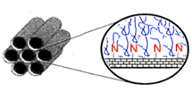
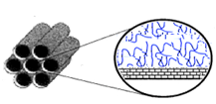
PE-SBA-15 Double functionalization :
AP (N) grafting + TEPA/PEI impregnation (2)
Irreversible adsorption (chemisorption)
Grafting
+
Impregnation
Impregnation
Increased CO2 adsorption for
grafted+impregnated materials
(not only due to higher N content)
140 mg/g (45ºC, 1 bar)
There is a better accesibility of CO2
to neighbour amino groups, which
improves carbamate formation
and therefore CO2 adsorption.
This is due to a better dispersion and enhanced mobility of impregnated molecules
A synergic effect seems to take place
for double functionalized adsorbents
Yue, 2008 Chem. Eur. J.
Sanz et al. J. Mater. Chem. A 1 (2013) 1956-1962
Notes:
Las isotermas de CO2 muestran un incremento importante en la capacidad de adsorción de los materiales doblemente funcionalizados, particularmente para el impregnado con TEPA, que a 1 bar (45ºC) alcanza casi 140 mg/g. Este valor está muy por encima de los obtenidos para los soportes con una sola funcionalización: solo por anclaje (66 mg/g) o solo por impregnación (95 mg/g), como se verá en la tabla siguiente.
Todas las isotermas muestran las características ya mencionadas, asociadas a la quimisorción: cantidades importantes adsorbidas a muy baja presión, poca variación posterior con la presión, e irreversibilidad de la isoterma (con rama de desorción prácticamente horizontal).
Los resultados apuntan a un efecto sinérgico de ambos métodos de funcionalización combinados, que estaría relacionado con la mejor accesibilidad del CO2 a los grupos amino. Detalle de la explicación: Los grupos amino muy próximos a la superficie de la sílice en los materiales impregnados tienen mas dificultad para interaccionar con otros grupos amino necesarios para la adsorción del CO2 (formación del carbamato según el mecanismo). Con la nueva ruta de funcionalización se favorece un mayor contacto entre los grupos amino incorporados mediante las dos técnicas, lo cual favorece la eficiencia de adsorción de los grupos amino. Ademas, tambien se produce una mejora de la difusión y la movilidad de las moléculas impregnadas, facilitando con ello la difusión del CO2.
En la bibliografia se describe que incluso las moléculas de surfactante existentes en los poros del material pueden facilitar la eficacia de la impregnación.
La eficacia en la captura de CO2 es mayor para las muestras preparadas por doble funcionalización debido a varios motivos: la mayor dispersión de los compuestos impregnados en una superficie irregular (Yue, 2008 Chem. Eur. J.), el mejor contacto entre grupos amino (de los compuestos impregnados y anclados) y quizás también la mayor movilidad de los impregnados.

Slide 48
PE-SBA-15 Double functionalization :
AP (N) grafting + TEPA/PEI impregnation (3)
Sample | N (wt. %) | mg CO₂/g | mol CO₂/ mol N
PE-SBA15-e-(N)-6 | 4.4 | 66 | 0.48
PE-SBA15-e-PEI (30) | 9.0 | 80 | 0.28
PE-SBA15-e-(N)-6-PEI (30) | 10.7 | 111 | 0.33
PE-SBA15-e-TEPA (30) | 9.4 | 95 | 0.32
PE-SBA15-e-(N)-6-TEPA (30) | 11.1 | 139 | 0.40
CO₂ adsorption in double-functionalized materials is higher
Efficiency of amino groups is also higher compared to impregnated materials, particularly for TEPA
Sanz et al. J. Mater. Chem. A 1 (2013) 1956-1962
Notes:
Aquí se muestran los valores numéricos de adsorción en los materiales doblemente funcionalizados. En ambps casos, PEI y TEPA, hay una clara mejora en la cantidad de CO2 adsorbida, en linea con el mayor contenido en N, pero también una mayor eficiencia de los grupos amino, que resulta mas destacada para TEPA que para PEI. Esta subida está relacionada con el efecto sinérgico antes comentado. En todo caso, las eficiencias alcanzadas son menores que las del material funcionalizado por anclaje (0,48), que se acerca mucho al máximo teórico posible en condiciones anhidras (0,5).

Slide 49
PE-SBA-15 Double functionalization :
AP (N) grafting + TEPA/PEI impregnation - 50% (1)
Metastable process?
(estabilization not attained)
For higher organic loads of TEPA (50%) ads. capacity and efficiency still increase.
Grafted/impregnated -TEPA (50) shows
the highest values: 215 mg CO₂ /g and
0,45 mol CO2/mol N (45 ºC, 1 bar).
For PEI, an increased load up to 50% produces the complete saturation of pore structure (hindered diffusion) and efficiency decreases
(not shown)
Sample and | N (wt %) | mg CO₂/ g | mol CO₂/ mol N
PE-SBA15-e-(N)-6 | 4.4 | 66 | 0.48
PE-SBA15-e-(N)-6-TEPA (30) | 11.1 | 139 | 0.40
PE-SBA15-e-(N)-6-TEPA (50) | 15.3 | 215 | 0.45
Sanz et al. J. Mater. Chem. A 1 (2013) 1956-1962
Notes:
Al aumentar mas la cantidad impregnada (50% TEPA) en el material previamente anclado, aumenta todavía mas la cantidad de CO2 adsorbida, alcanzándose cifras de adsorción notables (215 mg/g a 45ºC y 1 bar). El contenido algo mayor en nitrógeno (15,3% en TEPA-50 frente a 11,1% en TEPA-30), no es suficiente para explicar el mejor comportamiento en la adsorción de CO2, por lo que se atribuye también a la favorable disposición de los compuestos orgánicos. Al estar el PEI y TEPA sobre una cadena anclada previamente y no directamente sobre la pared, como ocurre en el caso de la impregnación directa, aumenta la movilidad del compuesto impregnado y por tanto, se mejora la etapa de formación del carbamato.
En el caso del PEI un aumento hasta 50% de PEI ya no favorece la adsorción de CO2, ya que con esta carga tan elevada y siendo un polimero muy viscoso (comparado con TEPA), la difusión del CO2 en los poros del material se ve muy limitada, no pudiendo acceder a una buena parte de los grupos amino del material. Esto hace que la eficiencia de adsorción baje al pasar de 30% a 50% de PEI, lo contrario de lo que ocurre con TEPA.
La perdida de eficacia de los materiales con PEI al aumentar la cantidad impregnada se debe a la mayor dificultad del CO₂ para acceder a todos los grupos amino incorporados. Por el contrario, en los materiales con TEPA la eficacia se mantiene o incluso aumenta al incrementar el contenido orgánico debido a que la mayor proximidad de las moléculas aminadas favorece su interacción con CO₂ más de lo que dificulta su difusión.

Slide 50
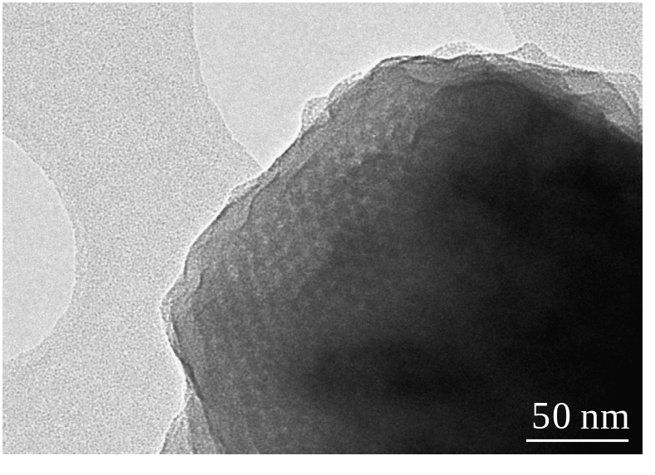
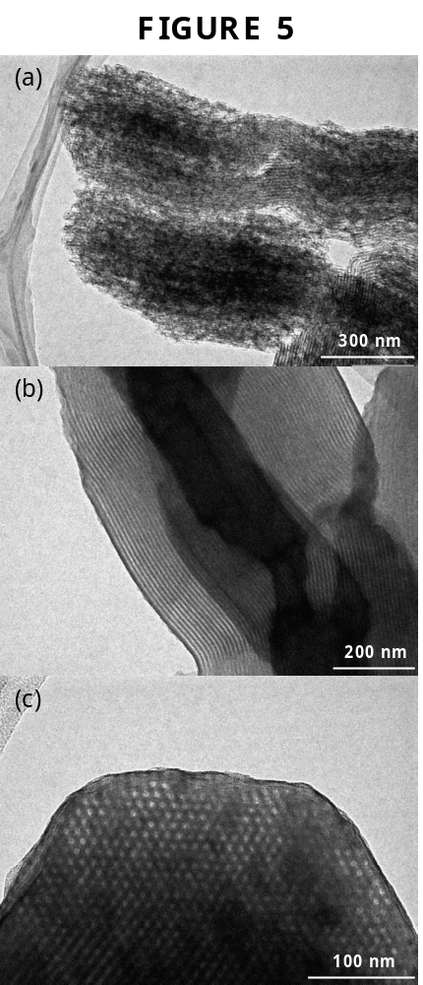
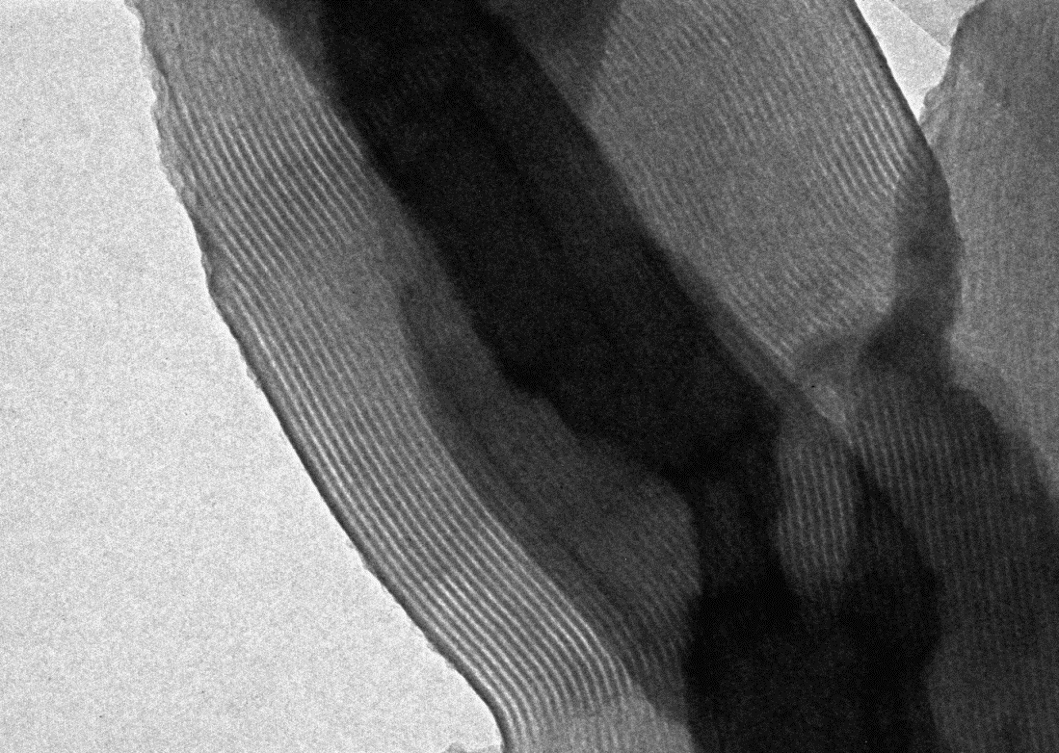
Amino groups location byTEM
Impregnated materials
IMPREGNATED SBA-15 after RuO₄ treatment
SBA-TEPA-30
SBA-PEI-50
RuO
Sanz et al. Micro. Meso. Mater .
158 (2012) 309-317
200 nm

Slide 51
PE-SBA-15 Double functionalization :
AP (N) grafting + TEPA/PEI impregnation - 50% (2)
Adsorption kinetics, 45ºc
(thermobalance)
TEPA
Double funct.
PEI
Double-functionalized adsorbents show faster CO₂ adsorption kinetics, very likely due to the better dispersion and higher mobility of impregnated molecules
Sanz et al. J. Mater. Chem. A 1 (2013) 1956-1962
Notes:
La velocidad de adsorción (máximo de las curvas derivadas) no varía significativamente entre las muestras impregnadas y las de doble funcionalización

Slide 52
PE-SBA-15 Double functionalization :
AP (N) grafting + TEPA/PEI impregnation - 50% (2)
Adsorption kinetics (thermobalance)

Slide 53
PE-SBA-15 Double functionalization
CO₂ adsorption from gas mixture
(15% CO₂, 80% Ar, 5% O₂) + 5% H₂O (sat.)
CO₂ adsorption is enhanced in wet conditions for TEPA materials, (adsorption mechanism: bicarbonate formation)
Sample | Pure CO₂ (0.15 bar) | Gas Mix
PE-SBA15-e-(N)-6-TEPA (30) | 131 | 162
PE-SBA15-e-(N)-6-TEPA (50) | 190 | 235
PE-SBA15-e-(N)-6-PEI (30) | 120 | 116
For PEI material this effect is not observed, probably due to the high organic density
CO₂ + 2 RNH₂ RNH₃⁺ + RNHCOO⁻
NH₂ /CO₂ = 2/1
Adsorption/Desorption cycles
CO₂ + RNH₂ + H₂O RNHCOO⁻ + H₃O⁺
NH₂ /CO₂ = 1/1
TEPA adsorbents show a decrease in adsorption along the 4 cycles (higher volatility)
PEI adsorbent is stable after cycles
Sanz et al. J. Mater. Chem. A 1 (2013) 1956-1962
Notes:
La estabilidad de los materiales obtenidos por doble funcionalización es análoga a la de los impregnados: los de PEI son estables pero los de TEPA no, posiblemente debido a una evaporación parcial de este último. (Datos obtenidos en lecho fijo)

Slide 54
CONCLUSIONS
Pore expanded SBA-15 materials provide an improved incorporation of functional groups inside the cavities for specific adsorption purposes, i.e. amino groups for selective CO2 adsorption.
A synthesis method has been developed to prepare highly selective adsorbents for CO2 capture based on two consecutive functionalization steps: grafting and impregnation. This procedure has provided highly amino-loaded materials with increased values of CO2 adsorption capacity and capture eficiency, being the highest values obtained: 215 mg CO2/g and 0,45 mol CO2/mol N (45ºC, 1 bar).
Amino groups incorporated by double functionalization interact more easily with CO2, compared to single one-step conventional functionalization procedures (either graftIng or imptregnation), due to a better interaction between amino moieties present in grafted+impregnated molecules. A synergic effect is produced.
CO2 adsorption is improved in wet conditions, due to the higher efficiency of amino groups, being double-fucntionalized PE-SBA-15 materials attractive for CO2 capture at industrial scale, although stability should be improved.

Slide 55
THANK YOU
FOR YOUR ATTENTION

Slide 56
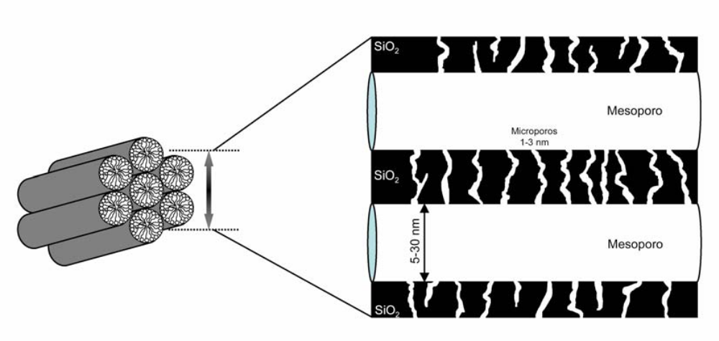
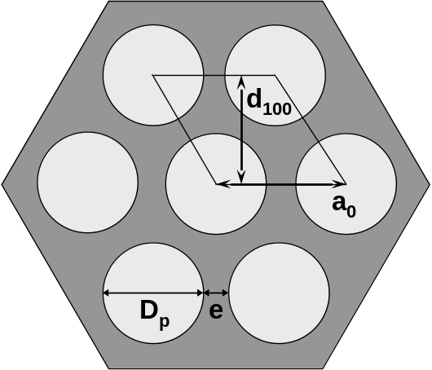
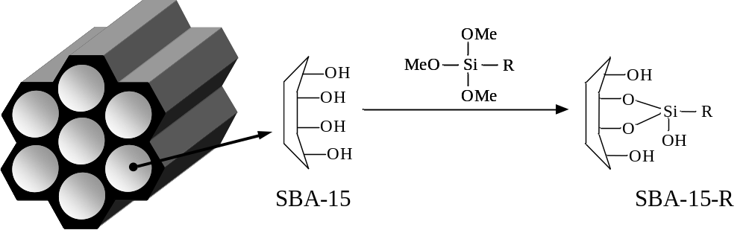
oculta
Figura 2.17. Material SBA‑15 calcinado, formado por canales mesoporosos (geometría hexagonal) y canales microporosos que los interconectan.
Figura 2.16. Vista del material SBA‑15 desde la orientación [100] con los parámetros típicos de la estructura: espaciado interplanar (d100), distancia entre centros (a0), diámetro de poro (Dp) y espesor de pared (e)
Figura 2.19. Funcionalización de un soporte silíceo mesoestructurado por anclaje con un compuesto organosilano.

Slide 57
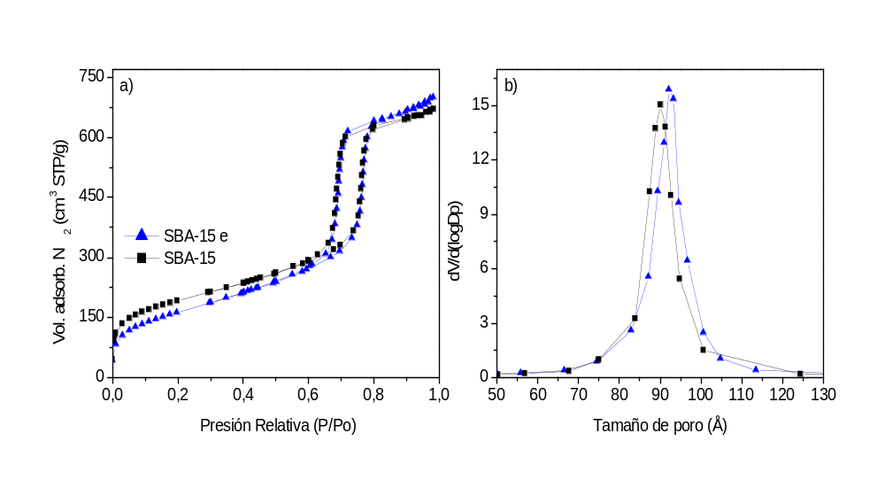
Figura 5.1. a) Isotermas de adsorción-desorción de N₂ a 77 K y b) distribución de tamaños de poro de los soportes silíceos mesoestructurados SBA‑15 calcinado y extraído con etanol

